Slide 1
Israel elections - leaders' descriptions by articles
A Project in Digital Humanities
Avishag Sahar | January 2020

Slide 2
intoduction
On the last year, the Israel state faced 2 rounds of elections to the government.
Now, we are going towards the 3th round which is planned to be on March 2nd 2020.
Due to these circumstances, I would like to understand how politicians are being covered in the press – specifically in newspapers articles.

Slide 3
specifications
To be more specific, we’ll investigate 10 key figures – 10 politicians.
ביבי
גנץ
ליברמן
אשכנזי
יאיר לפיד
בוגי
אמיר פרץ
סתיו שפיר
גדעון סער
מירי רגב

Slide 4
Technical steps

Slide 5
Step 1 – data preparation
Organize politician’s names and their nicknames\aliases in database:
<LeaderName> nvarchar (max) | <LeaderNameAlias> nvarchar (max)

Slide 6
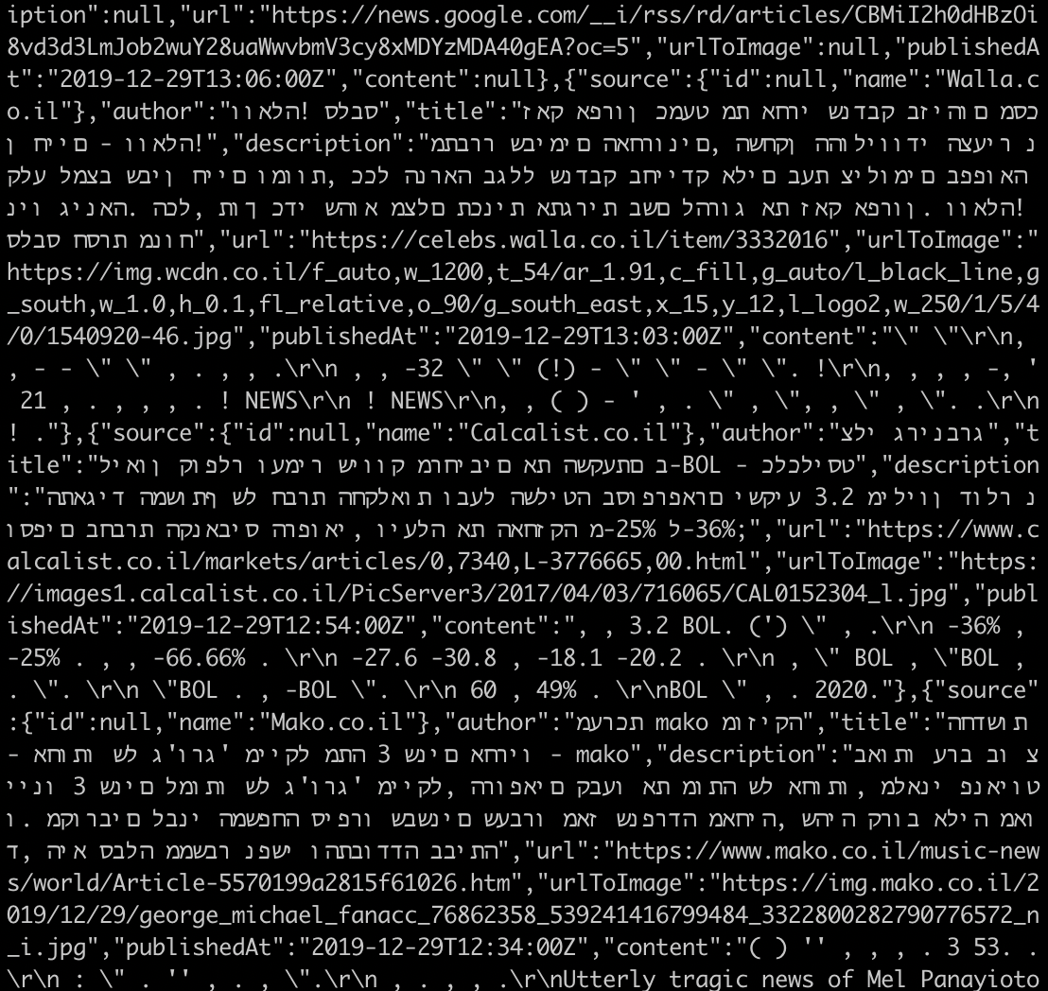
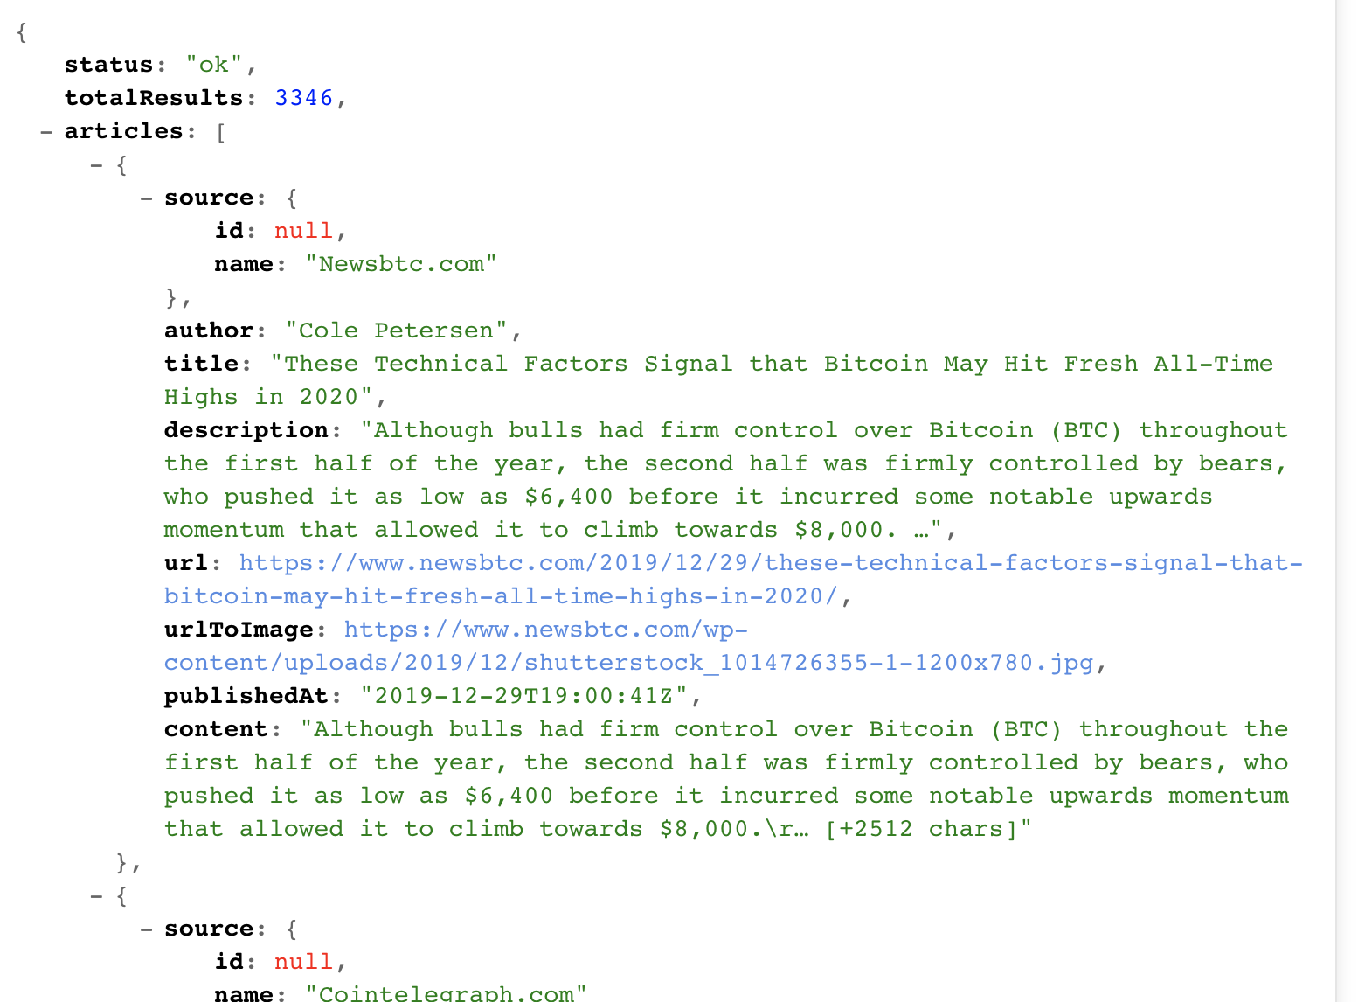
Step 2 – getting articles
I’ll use https://newsapi.org/ API to get the Articles in Hebrew.

Slide 7
Step 3 - process the text
Parsing articles.
Filter articles if one is related to politician’s name (or nickname\aliases)
Extract the sentences with the names.

Slide 8
Step 4 -
Tag words by the tool: https://github.com/OnlpLab/yap
Extract adjectives.
Map adjectives to a politician.

Slide 9
Step 5 – analyze the results
Analyze the results and understand one’s reputation.

Slide 10
What I hope to get
Hopefully, after the results analyzation, we’ll see whether a leader’s description in the press, can supply a good answer for us to the election’s results.

